Slide 1
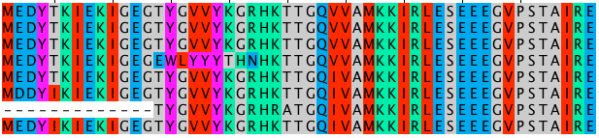
Multiple Sequence Alignment
MSA

Slide 2
Definition
Pair wise Sequence Alignment(PSA) is used to identify regions of similarity that may indicate functional, structural and/or evolutionary relationships between two biological sequences (protein or nucleic acid).

Slide 3
Definition
Multiple Sequence Alignment (MSA) is generally the alignment of three or more biological sequences (protein or nucleic acid) of similar length. From the output, homology can be inferred and the evolutionary relationships between the sequences studied.

Slide 4
MSAs require more sophisticated methodologies than pair wise alignment because they are more computationally complex.

Slide 5
Algorithms for performing MSA
Dynamic Programming
- Not practical
Progressive Alignment Construction
- Star alignment
- Guide tree approach
Iterative Methods

Slide 6
Dynamic Programming
A direct method for producing an MSA to identify the globally optimal alignment solution.
An extension of the pair wise alignment
- Alignment of k sequences to k sequences
- k(k-1)/2 possible sequence comparisons

Slide 7
Dynamic Programming
For proteins, this method usually involves two sets of parameters: a gap penalty and a substitution matrix assigning scores or probabilities to the alignment of each possible pair of amino acids based on the similarity of the amino acids.
For nucleotide sequences a similar gap penalty is used, but a much simpler substitution matrix, wherein only identical matches and mismatches are considered.

Slide 8
Dynamic Programming Global Alignment
Assume columns are independent
- Score of alignment is sum of column scores
Generalization of methods for pair wise alignment
- consider k-dimensional matrix for k sequences (instead of 2-dimensional matrix)
- each matrix element represents alignment score for k prefixes (instead of 2 prefixes)

Slide 9
EXAMPLE

Slide 10
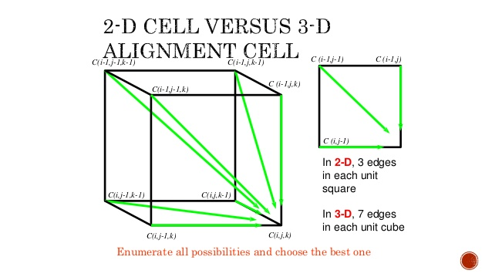

Slide 11
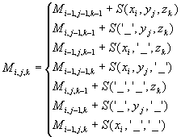
Distance Matrix for 3-sequences

Slide 12
Dynamic Programming
For n individual sequences, the naive method requires constructing the n-dimensional equivalent of the matrix formed in standard pair wise sequence alignment. The search space thus increases exponentially with increasing n and is also strongly dependent on sequence length.
MSA takes O(LengthNseqs) time to produce. To find the global optimum for n sequences this way has been shown to be an NP-complete problem.

Slide 13
Progressive Alignment Construction
The most widely used approach to multiple sequence alignments uses a heuristic search known as progressive technique (also known as the hierarchical or tree method) developed by Paulien Hogeweg and Ben Hesper in 1984.
Progressive alignment builds up a final MSA by combining pair wise alignments beginning with the most similar pair and progressing to the most distantly related.

Slide 14
Progressive Alignment Construction
The primary problem is that when errors are made at any stage in growing the MSA, these errors are then propagated through to the final result.
“ONCE A GAP IS ALWAYS A GAP”

Slide 15
Progressive Alignment Construction
STRATEGIES:
Star alignment
Tree alignment
Simple (quick and dirty) tree
At each time combine two, possibly singleton,sets of sequences

Slide 16
Progressive Alignment Construction
Progressive alignment methods are efficient enough to implement on a large scale for many (100s to 1000s) sequences.

Slide 17
STAR ALIGNMENT ALGORITHM
Input : Sequences S₁,S₂,…..S_{p}
-Build all O(p²) pairwise alignments.
-Let S_{c}= The sequence in S₁,S₂….S_{p} that is closest to the others.
That is choose Sc to minimize:
∑_{i≠c} a(S_{c} ,S_{i})
-Progressively align all other sequences to S_{c}.

Slide 18
Picking the centre in star alignments
Two possible approaches:
Try each sequence as the centre, return the best multiple alignment
Compute all pair wise alignments and select the string x^{c} that maximizes:
∑ sim(x_{i} , x_{c})
i≠c

Slide 19
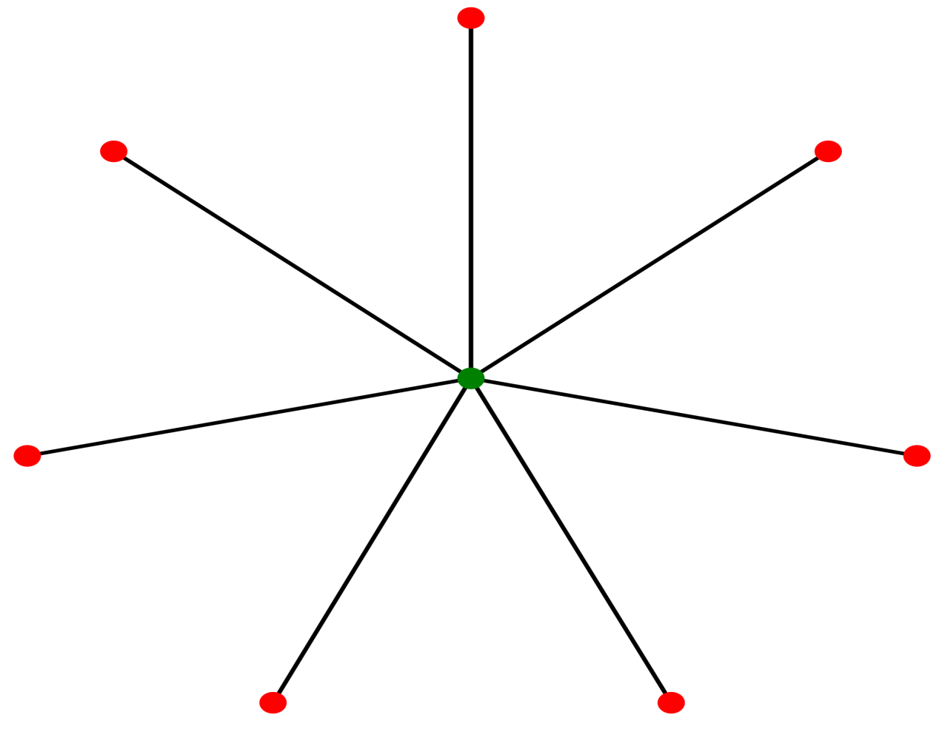
STAR ALIGNMENT ALGORITHM
S_{i}
a(S_{c} , S_{i})
S_{C}

Slide 20
EXAMPLE
Given Sequences:
ATTGCCATT
ATGGCCATT
ATCCAATTTT
ATCTTCTT
ATTGCCGATT

Slide 21
ATGGCCATT
ATTGCCATT
ATC-CAATTTT
ATTGCCATT--
ATTGCCATT
ATTGCCGATT
ATTGCC-ATT
ATCTTC-TT
ATTGCCATT

Slide 22
Comments about Star alignment
Conceptually simple
Dependent only upon pair wise alignments
Does not consider any position-specific information of the partial multiple sequence alignment while aligning a new sequence to it

Slide 23
THANK YOU

